Slide 1
Basics of Machine Learning
Final Project
Alperen VANLIOGLU
2nd Year SD Student
84493

Slide 2
Struggles
Ploting issiues
Seaborn library

Slide 3
Dataset
We have opted to analiyze the "World Happiness Report 2019" dataset available on Kaggle. This dataset comprises various variables that determine the happiness rank and score of countries across the globe. The happiness rank is based on the highest score, with the first rank indicating the best performance. The variables considered in the dataset are as follows:
Rank: Rank of Countries
Score : A metric measured by asking the sampled people the question: "How would you rate your happiness a scale of 0 to 10 where 10 is the happiest?"
GDP per capita (Economy) : The extent to which GDP contributes to the calculation of the Happiness Score.
Social support (Family) : The extent to which Family contributes to the calculation of the Happiness Score.
Healthy life expectancy (Health) : The extent to which Life expectancy contributed to the calculation of the Happiness Score.
Freedom to make life choices (Freedom) : The extent to which Freedom contributed to the calculation of the Happiness Score.
Perceptions of corruption (Trust) : The extent to which Perception of Corruption contributes to Happiness Score.
Generosity : The extent to which Generosity contributes to Happiness Score.

Slide 4
Purpose
Gain a better understanding of the data and extract insights that can help answer important questions.
Identify patterns and relationships between different variables, detect outliers and anomalies, assess data quality, test assumptions, and communicate findings effectively to others.

Slide 5
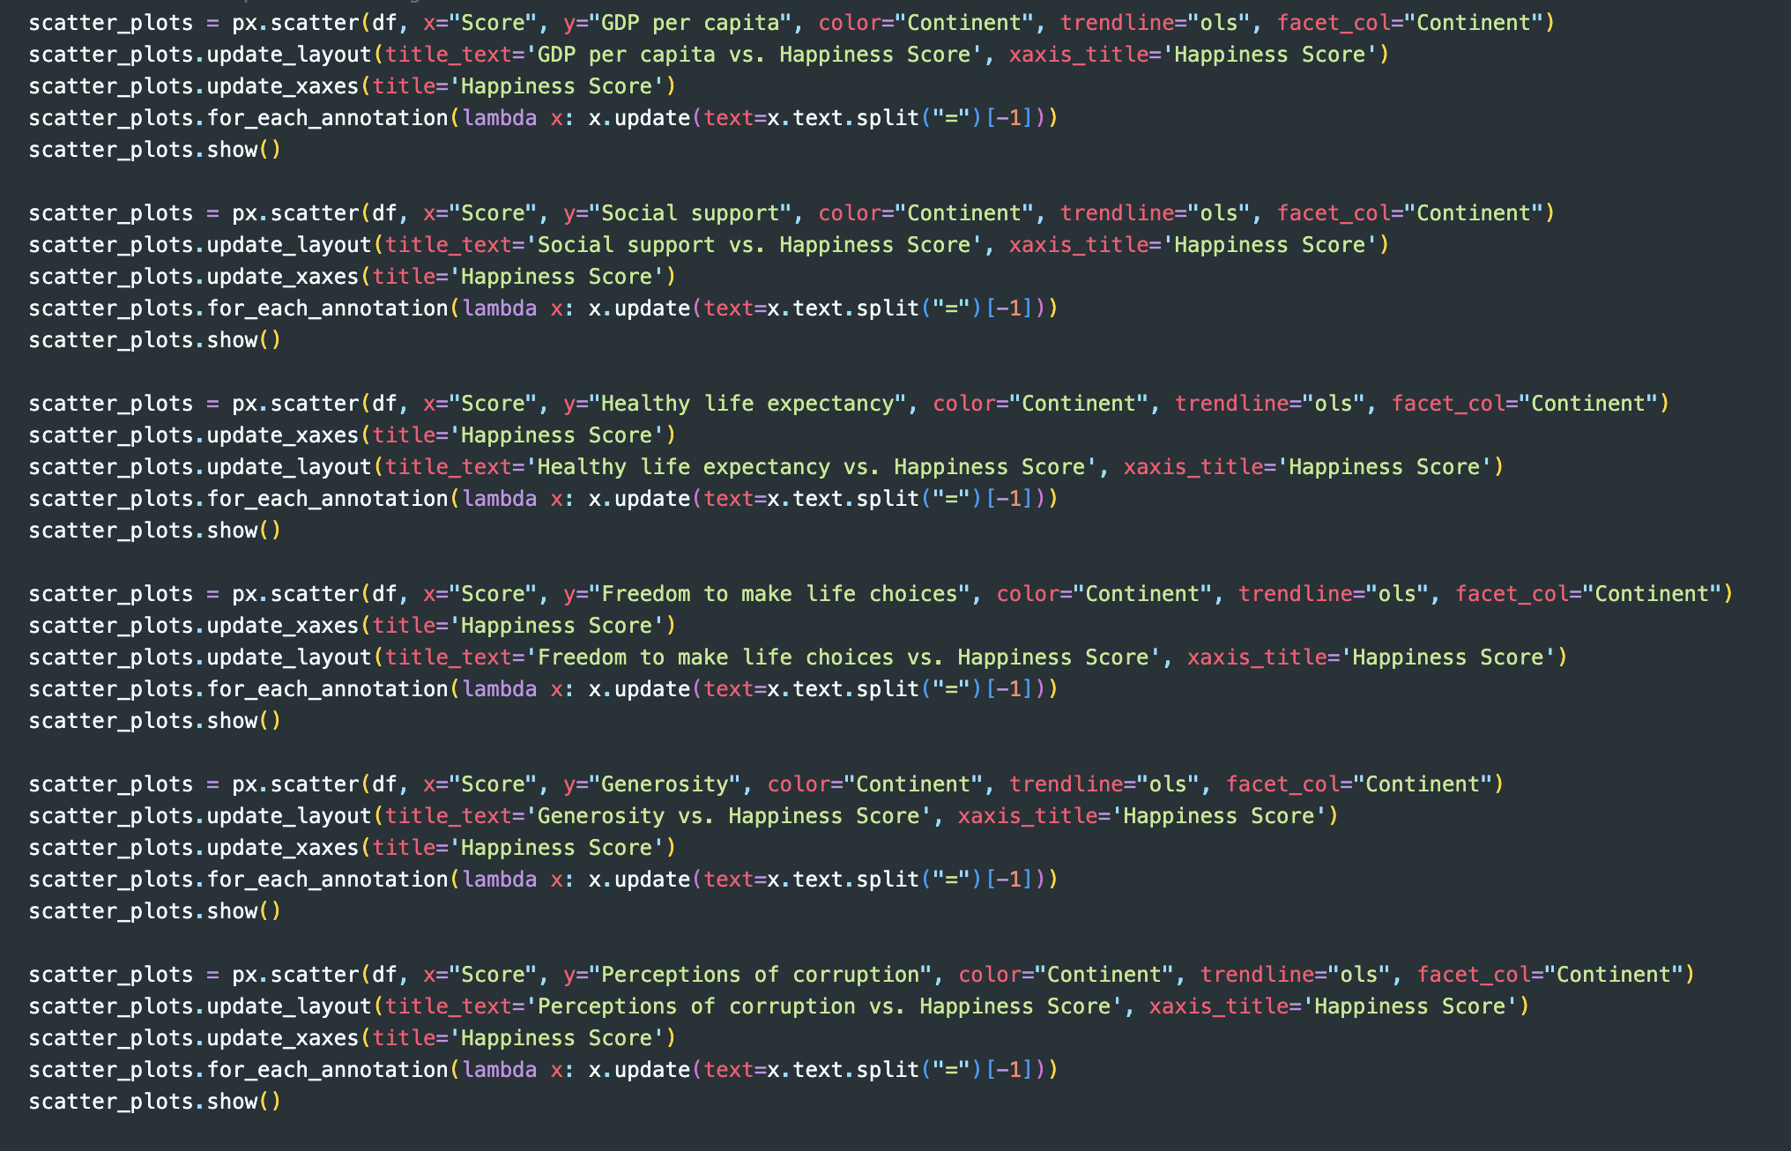
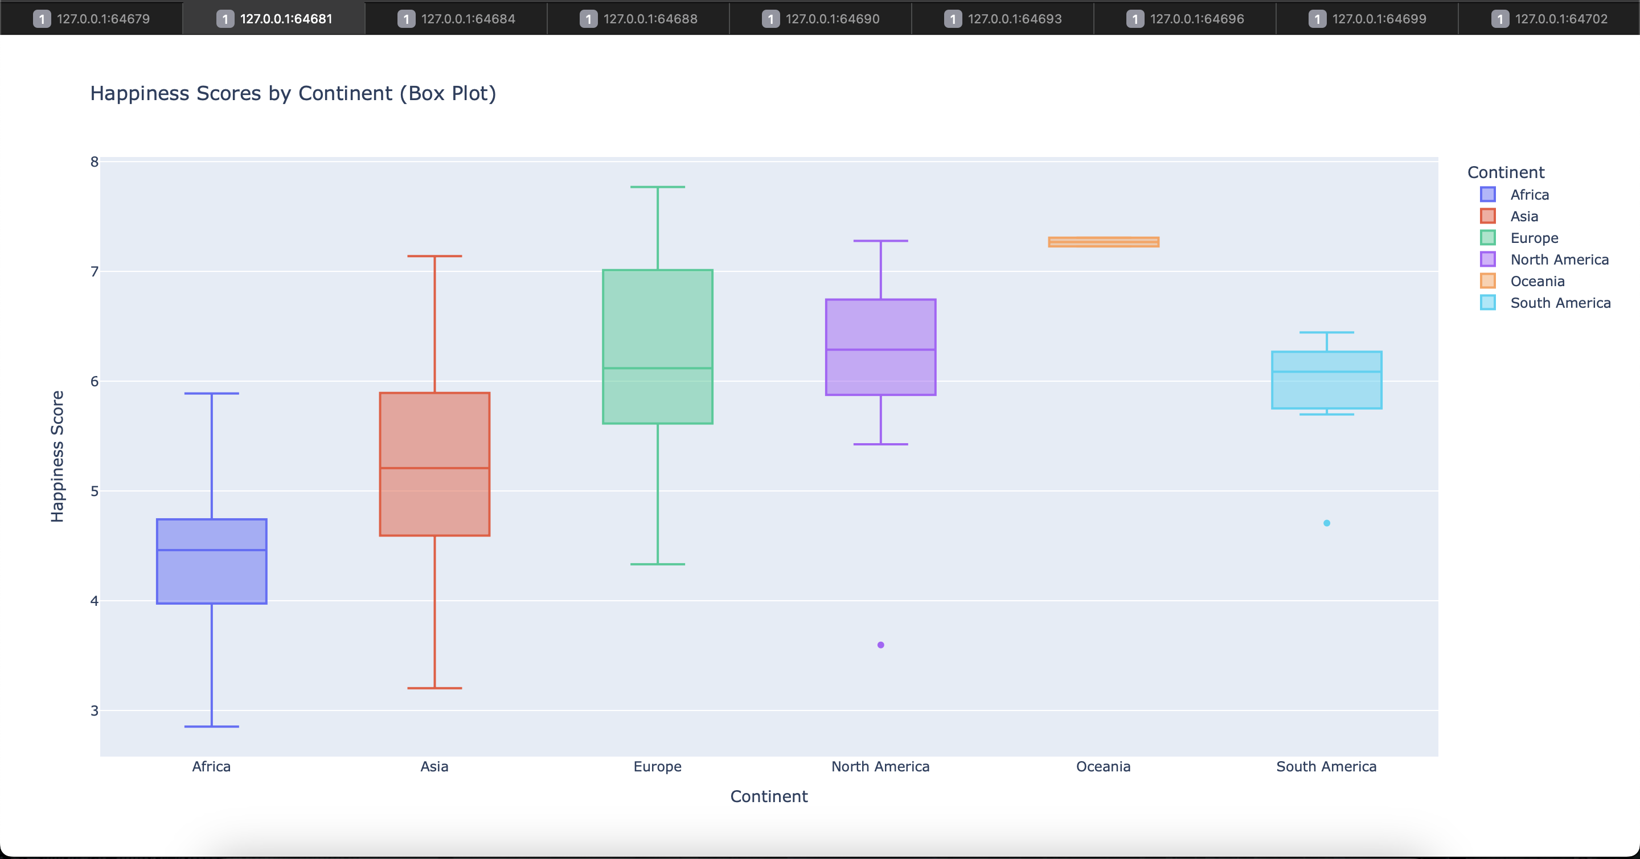
Screen captures

Slide 6

THANK YOU

